Slide 1


Film Management System
By Dingting Huang 001824907
Han He 001824967
Hanwen Guo 001828028

Slide 2
CONTENTS
01
Problem Statement
Use cases
04
Approach
Roles and more Description
02
05
06
Screen shots
03
Object Model

Slide 3
01
Problem statement

Slide 4
Problem statement
As there are many organizations and employees in film production industries, it is hard to manage so many people and the process of film production.
In addition, it is also very hard for sponsors to judge the films before finishing the film and choose the one that will bring the greater benefits.
As a director, when choosing the employees, they cannot know their performance before easily.
The emplyers cannot recognize their employees from multi-angle.

Slide 5
02
Approach

Slide 6
Approach
Choose Team
View Details
Rating others
Get scroes
Sponsor
1
2
3
4
5
Every people in the same team can view who is the members in the team.
Every people in the same team can view the history and scores of others.
After working, everyone can rate others in the same team.
According to a certain percentage, it will create a new score after others rate a person.
Sponsor and other staffs can view the details and history of every members in the team, so that they can decide whether sponsor and how much.

Slide 7
03
Object Model

Slide 8
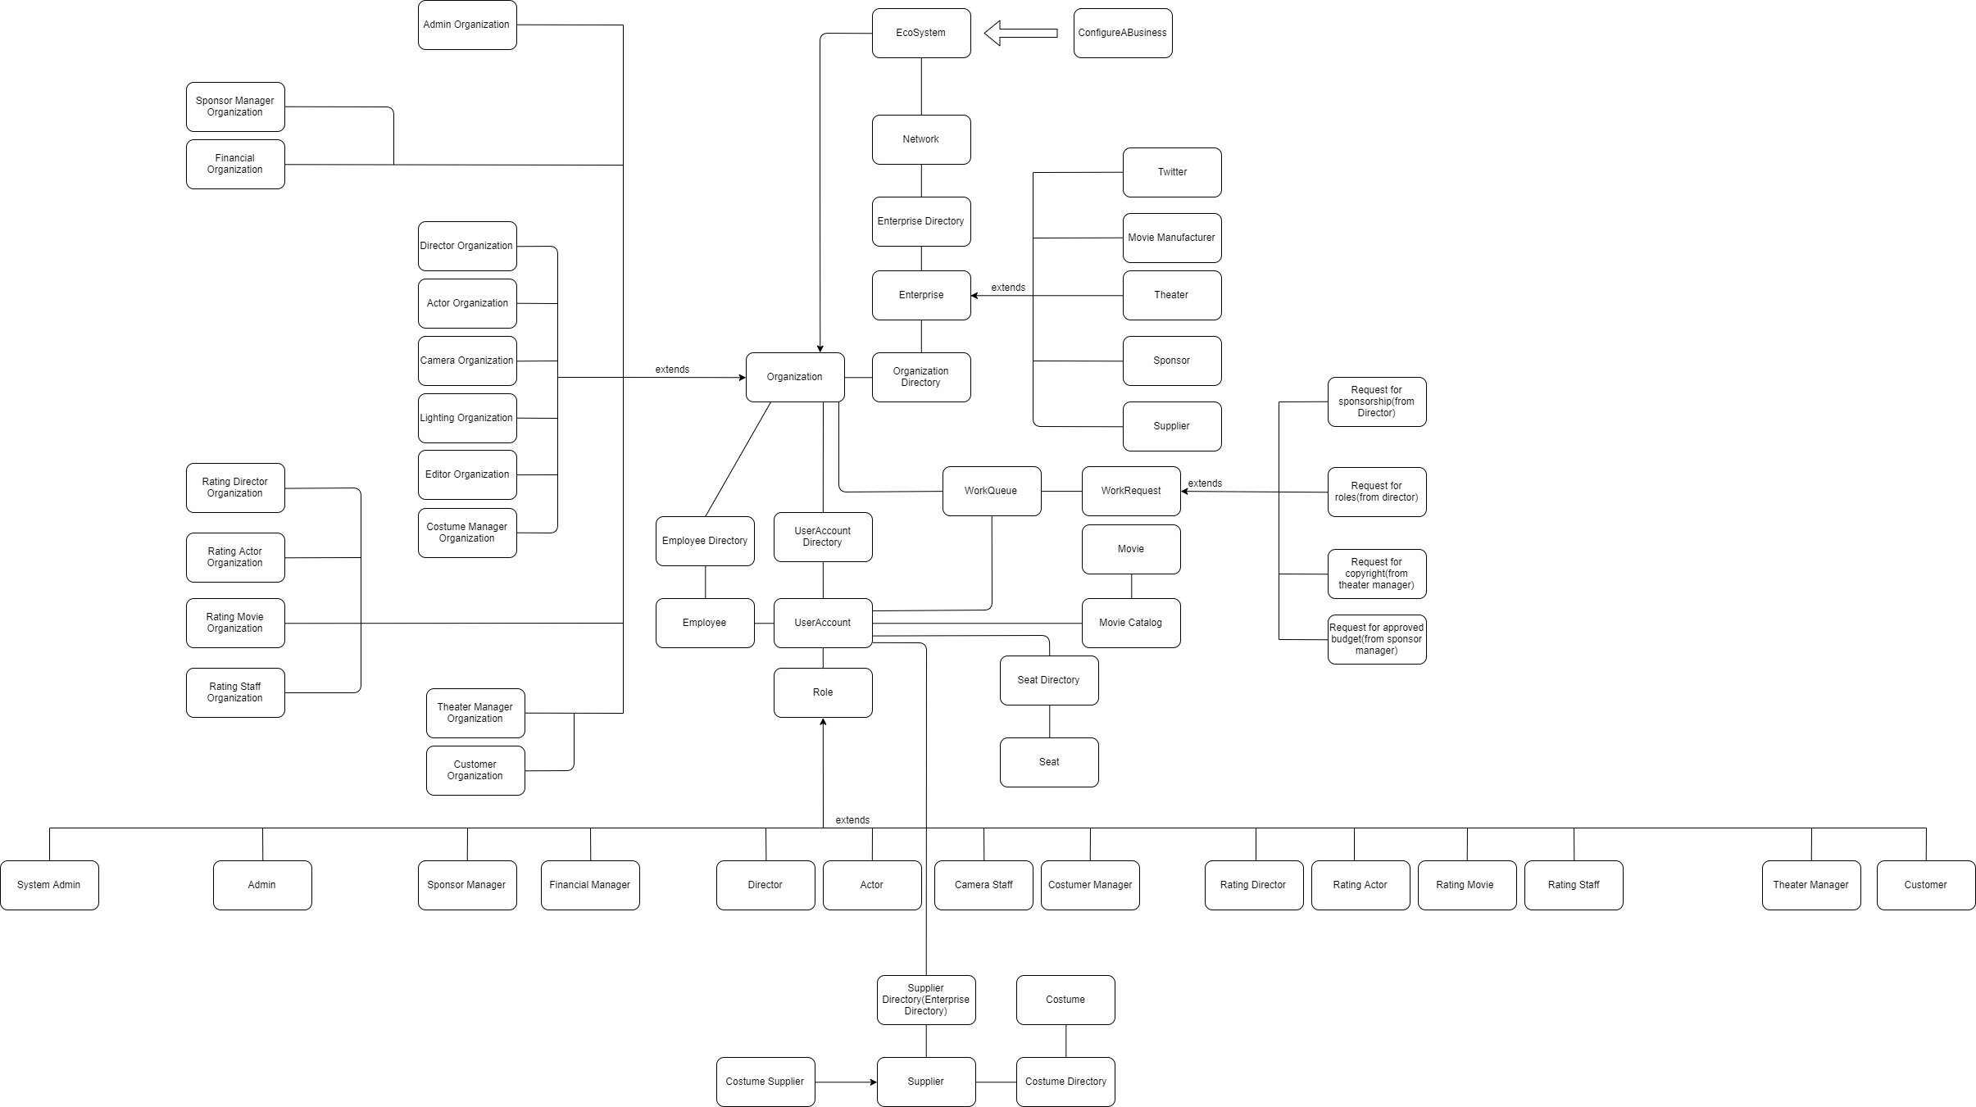

Slide 9
04
Use cases

Slide 10
Use cases
System with hierarchy and authorization.
Approval Procedures.
01
02
Digitizing the process of movie manufacture
Reasonable and logical rating system
03
04
Multiple commercial cooperation between sponsor, supplier, theater and movie manufacturer.
The application of API.
05
06
Buy the copyright and arrage the movie show time.
Comment from rating members.
07
08

Slide 11
Roles and more Description
05

Slide 12
Sponsor
1. Admin
2. Financial
3. Sponsor Manager
Roles and more Description
Movie Manufacture
1. Director 2. Actor 3. Costume Manager 4. Lighting man 5.Editor 6. Camera man 7. Admin
Supplier
1. Admin
2. Supplier Manager
Moive Rating
1. Director 2. Actor 3. Other 4. Rating members 5. Admin
1. Admin
2. Customer
3. Theater Manager
Theater

Slide 13
06
Screen shots

Slide 14
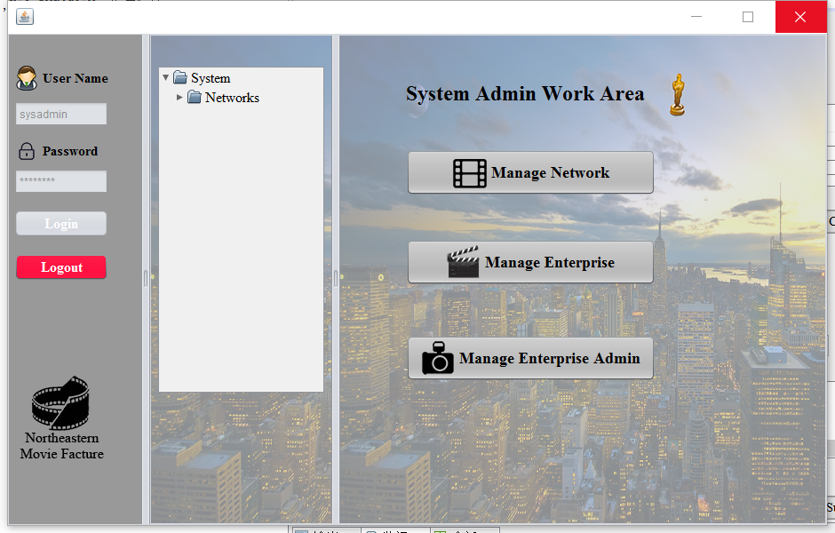
System Admin Panel
Manage Network
Manage Enterprise
Manage Enterprise Admin

Slide 15
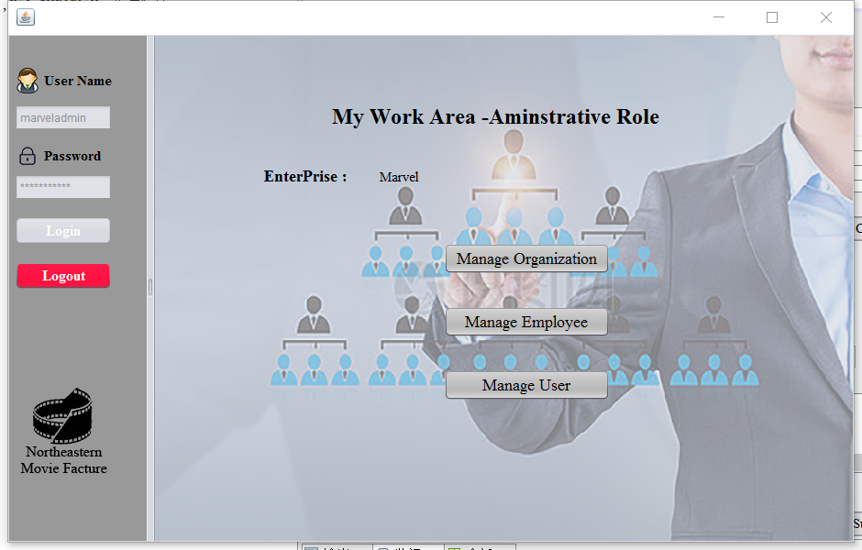
Admin Panel(Each Enterprise)
Manage Organization
Manage Employee
Manage User

Slide 16
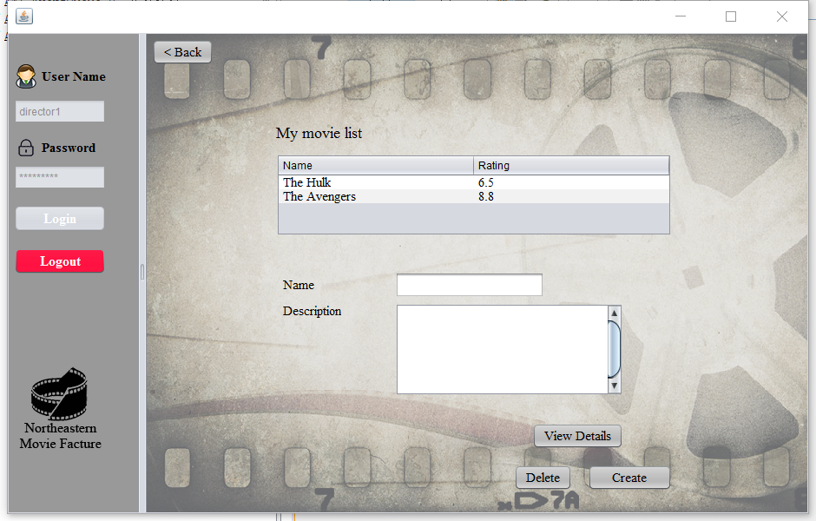
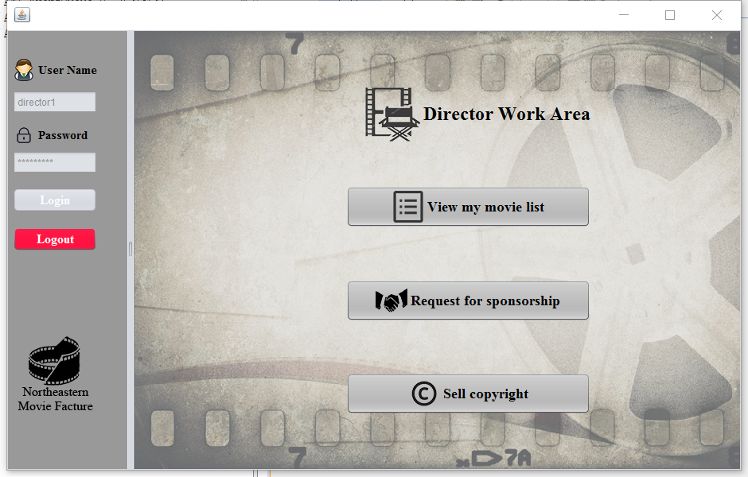
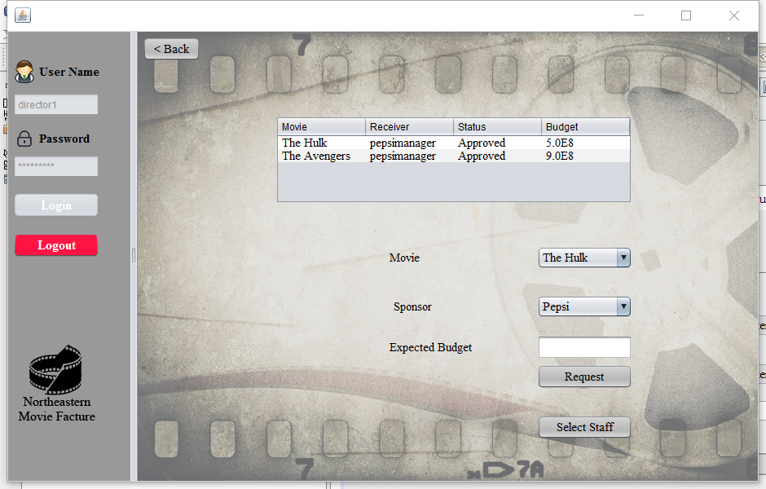
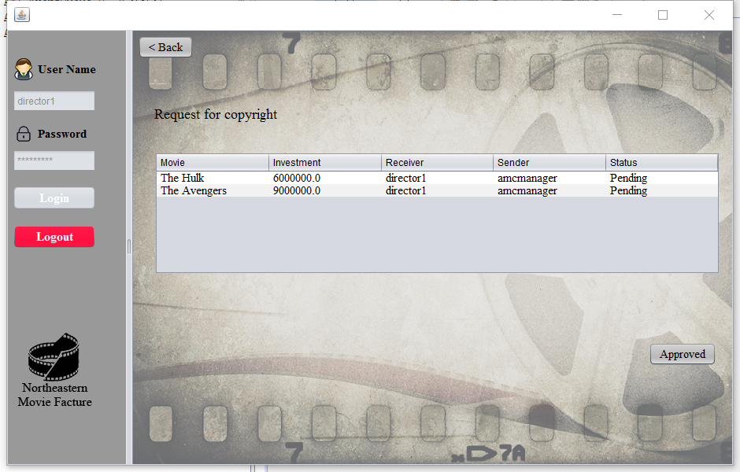
Director Panel
Create, delete and view the moive detail
Approve the request from the theater

Slide 17
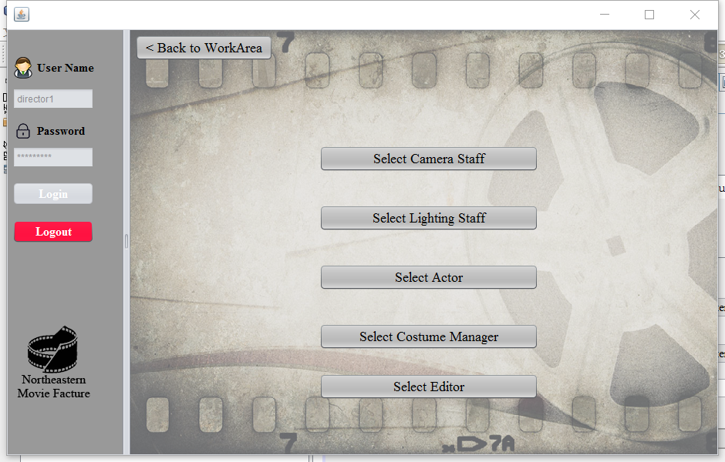
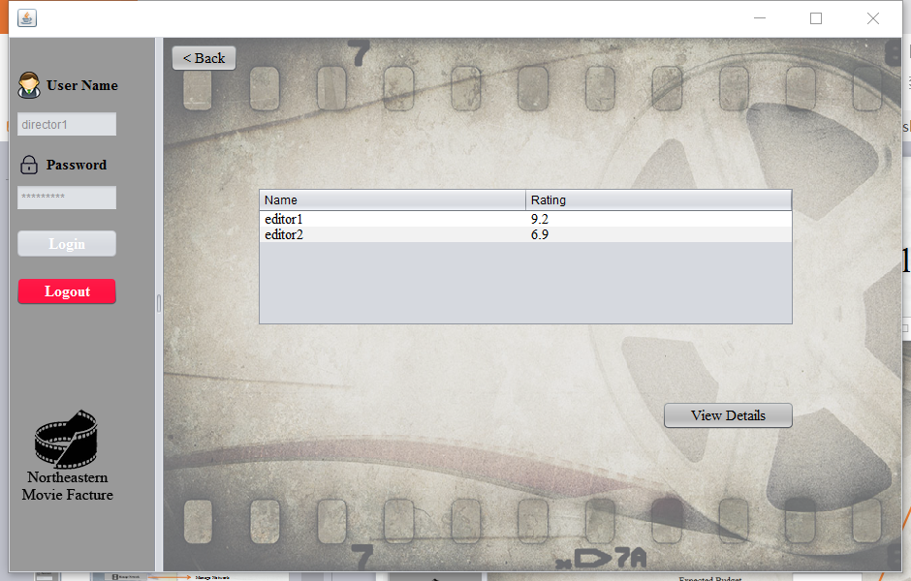
Director Panel
Send Request to Sponsor

Slide 18
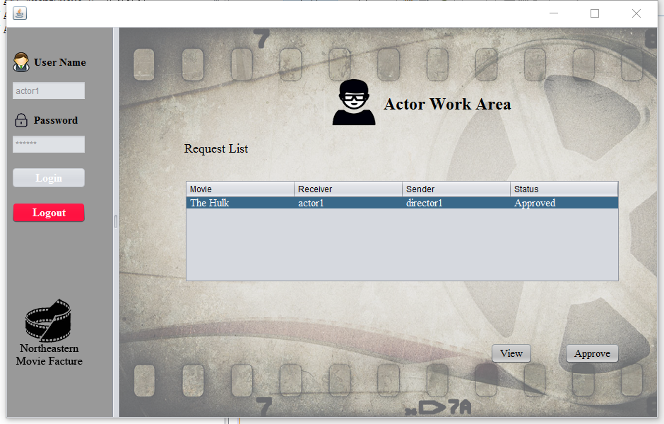
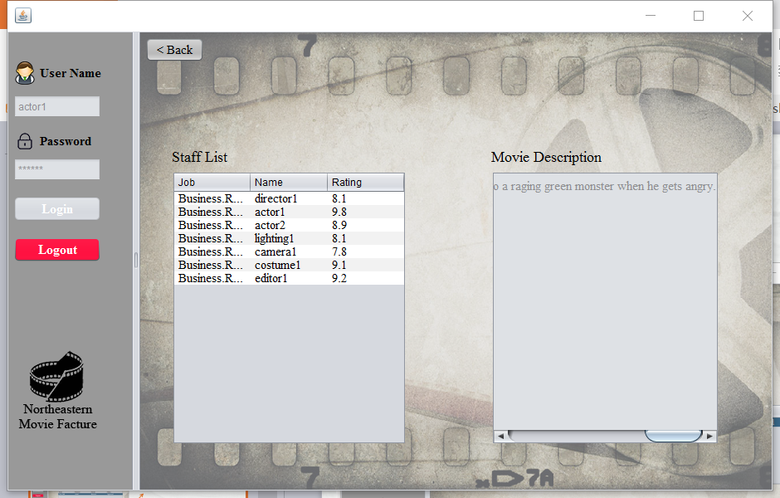
Actor Panel
Approve the request from director

Slide 19
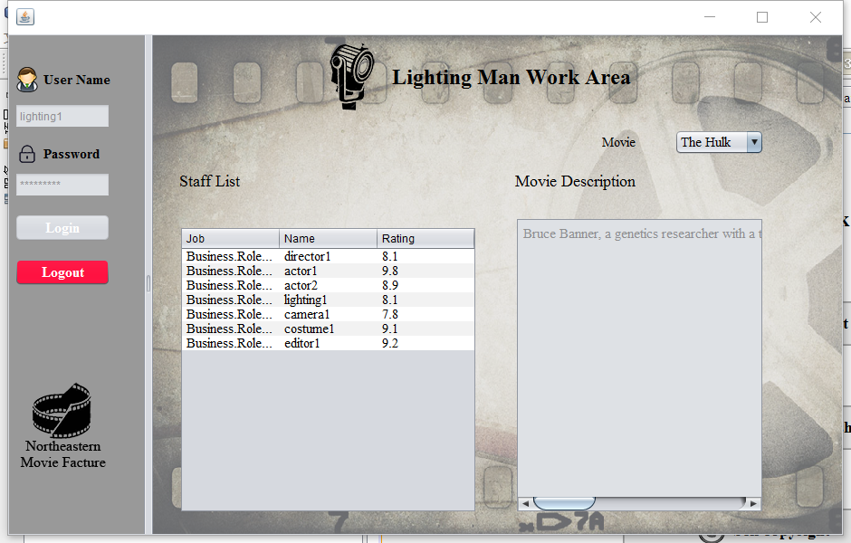
Editor, lighting and Camera man Panel

Slide 20
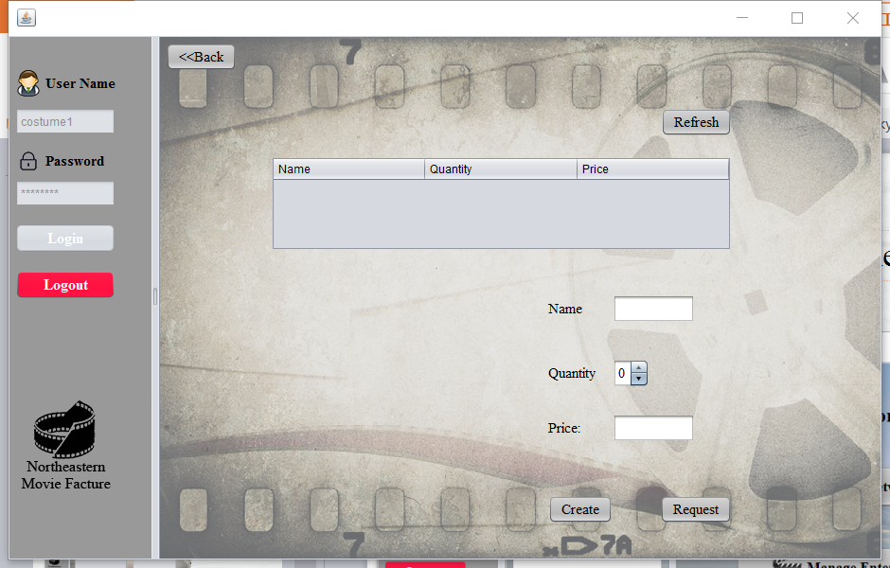
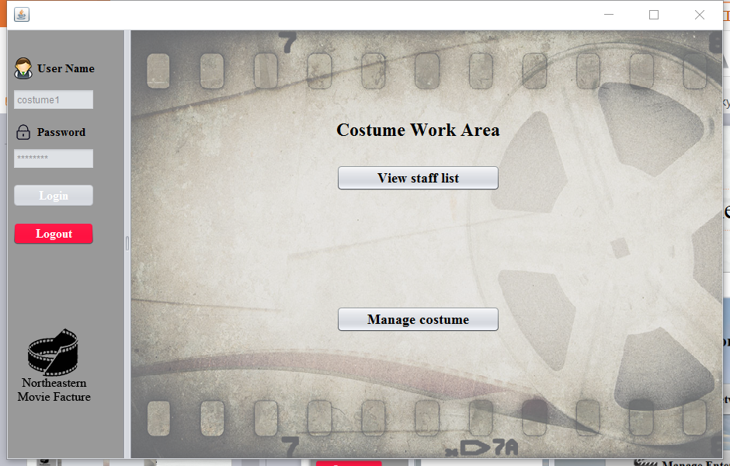
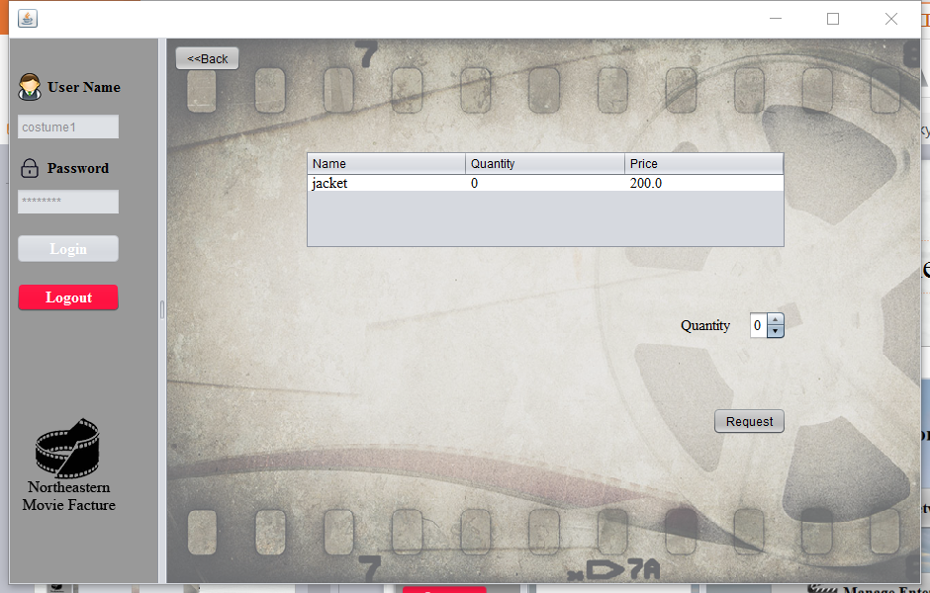
View the staff list like other staff
Costume Panel
Create the costume you want
Send request to supplier

Slide 21
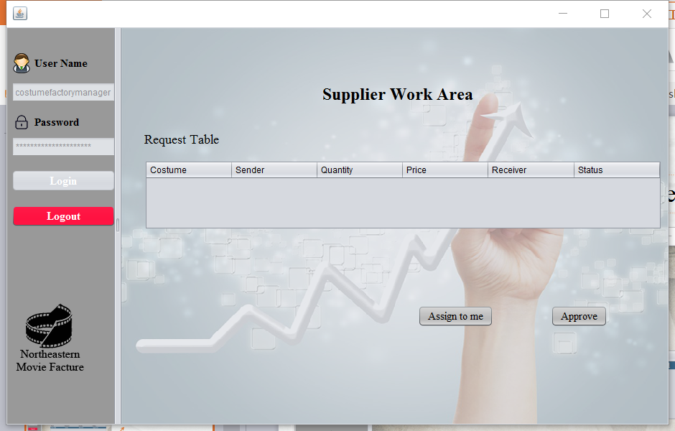
Supplier Panel
Approve the request from costume manager

Slide 22
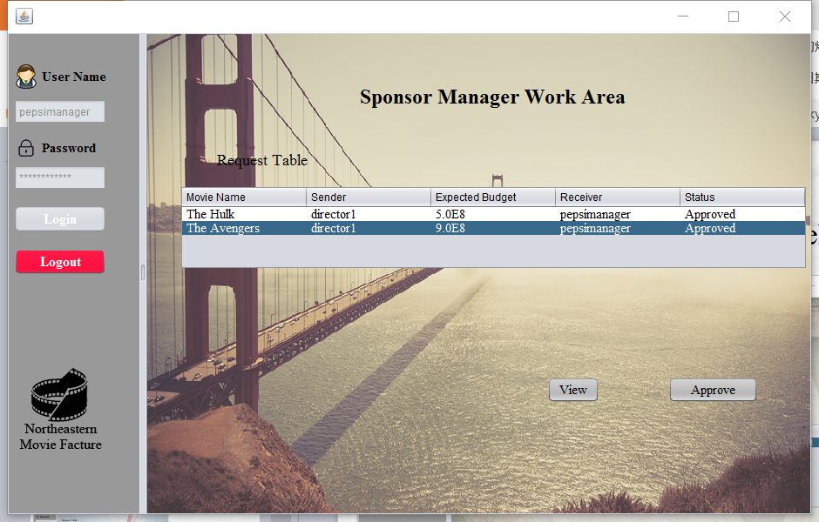
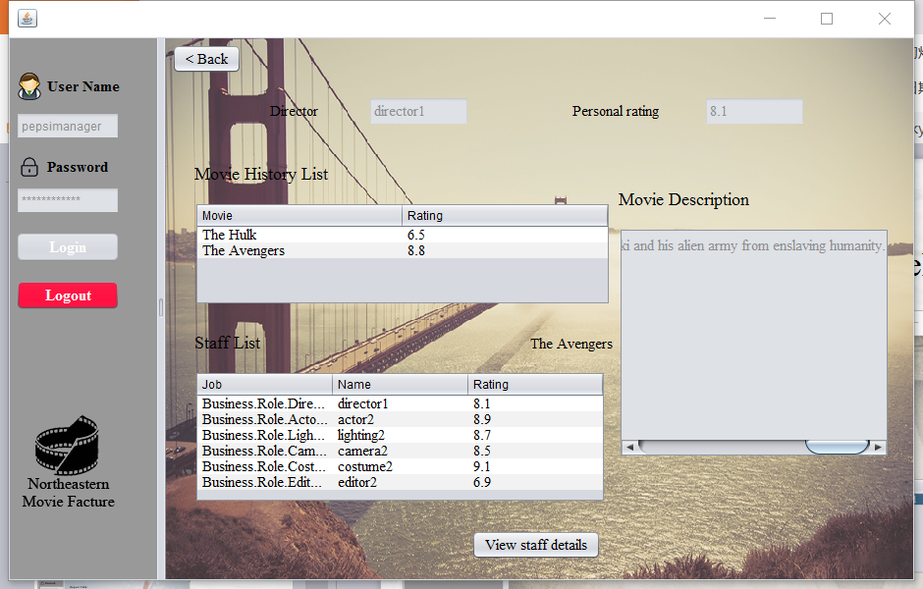
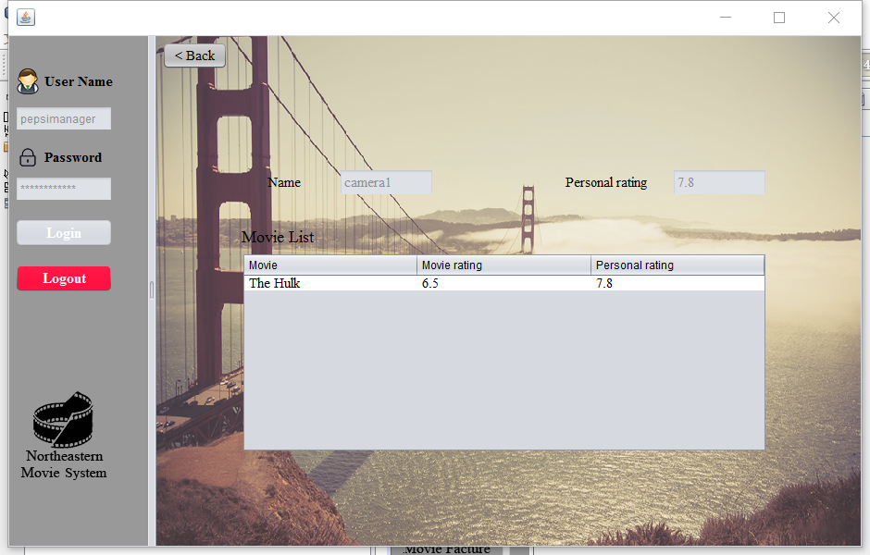
Sponsor Manager Panel
Approve the request from director and it will be sent to financial manager.

Slide 23
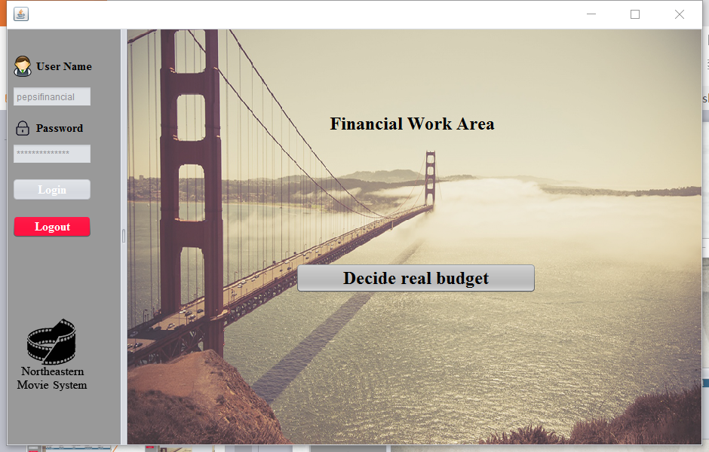
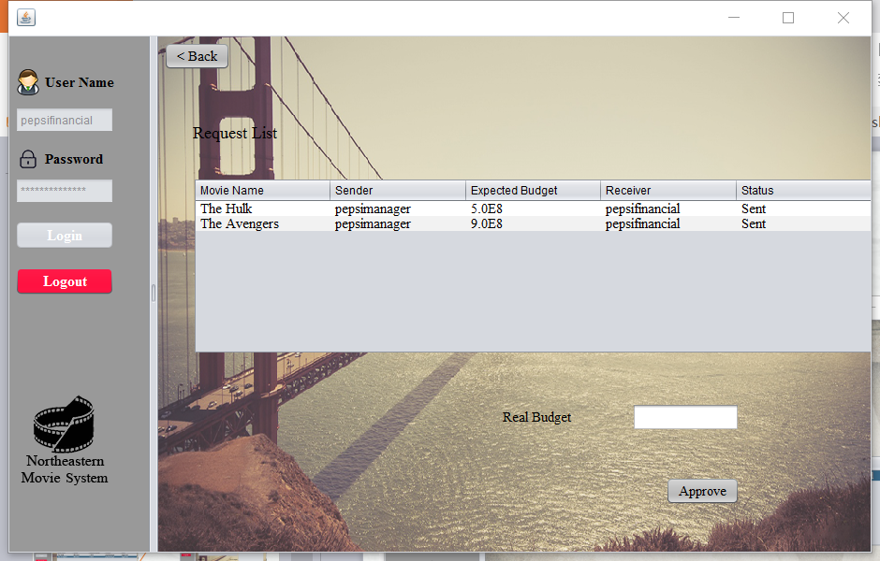
Financial Panel

Slide 24
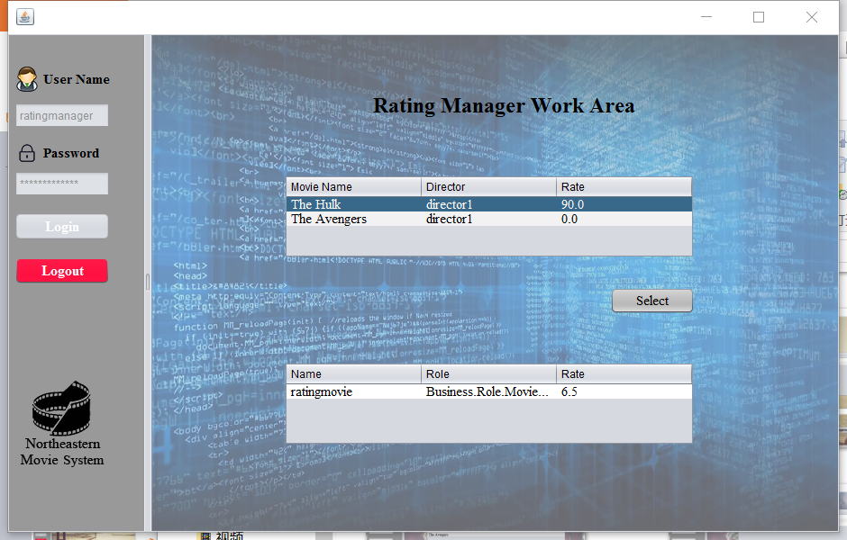
Rating Manager Panel

Slide 25
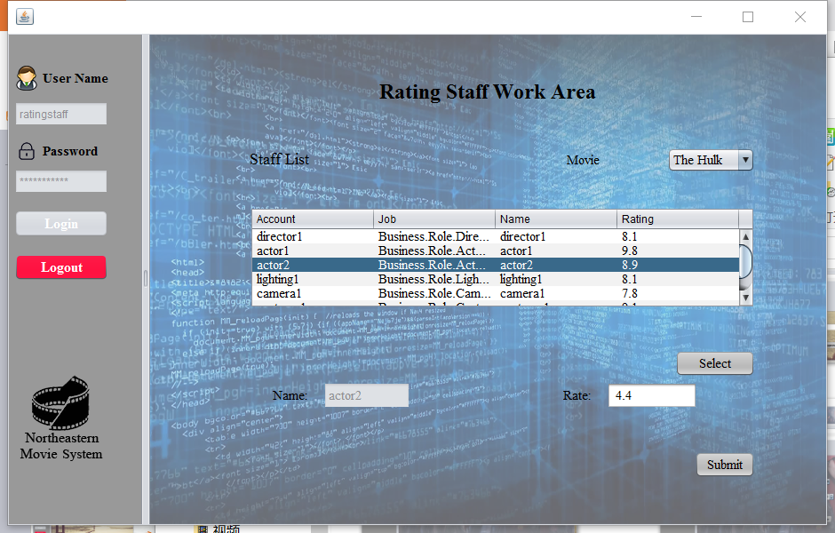
Rating staff, actor, director Panel

Slide 26
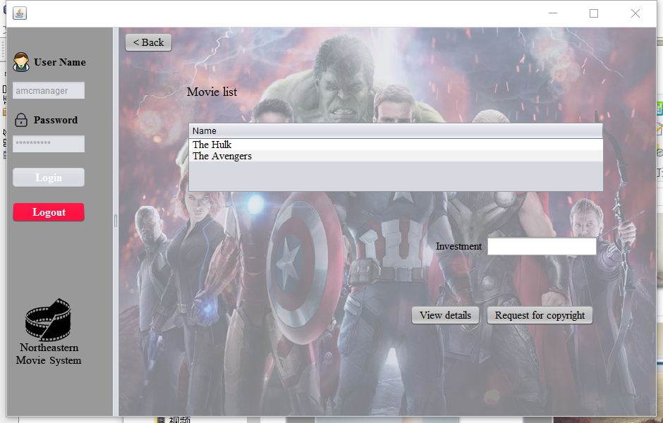
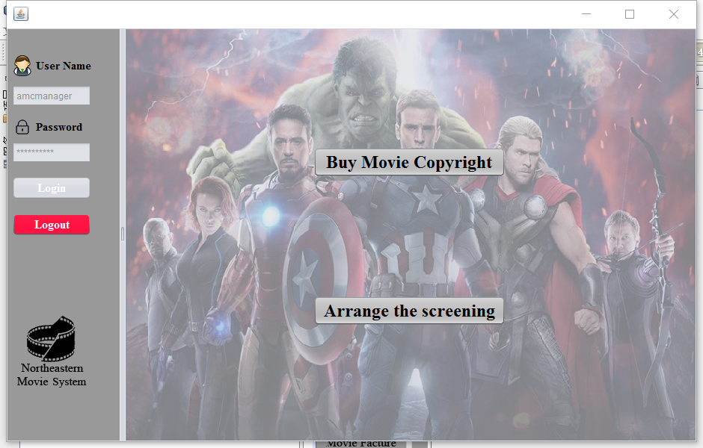
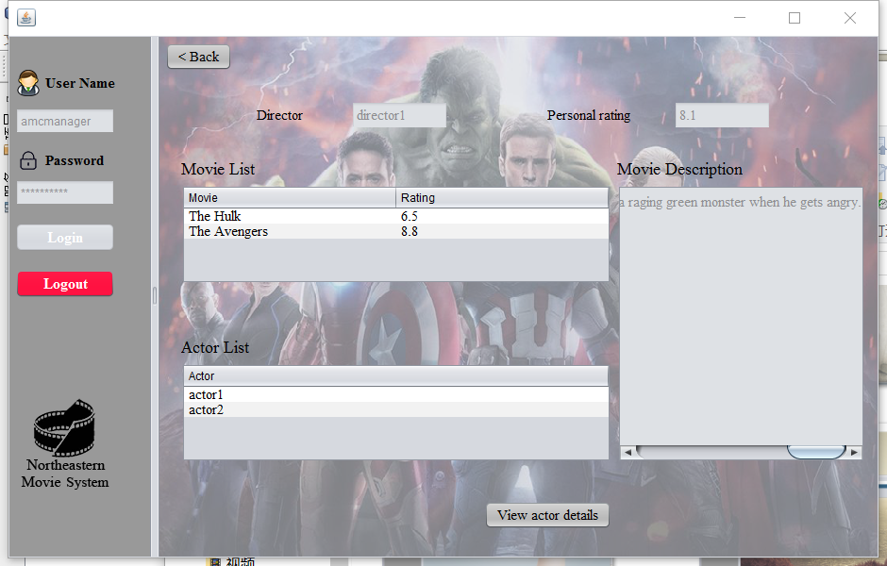
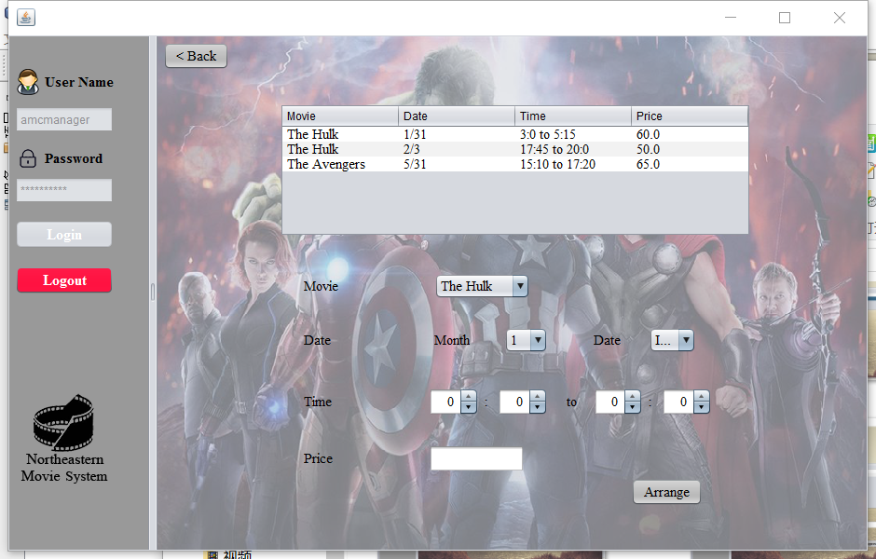
Theater Manager Panel
Send request to director
View details of the actor
Arrange the time of show movie

Slide 27
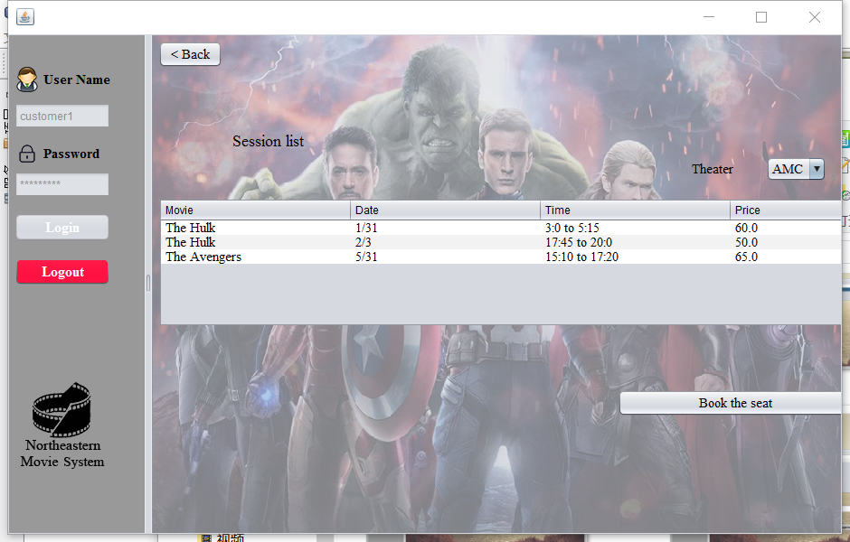
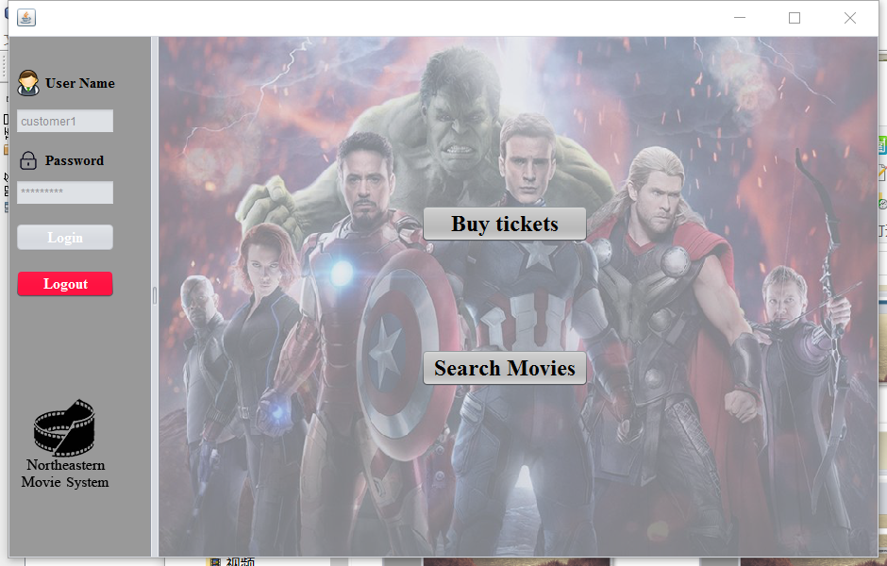
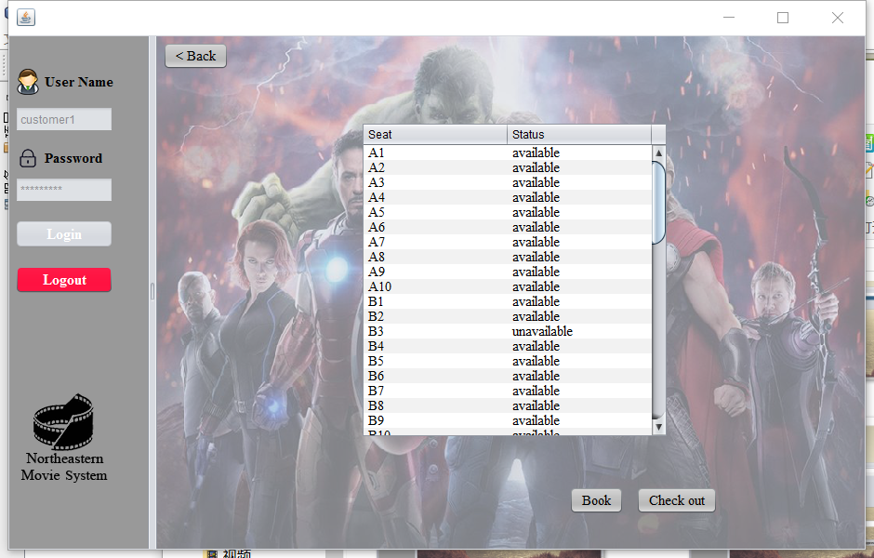
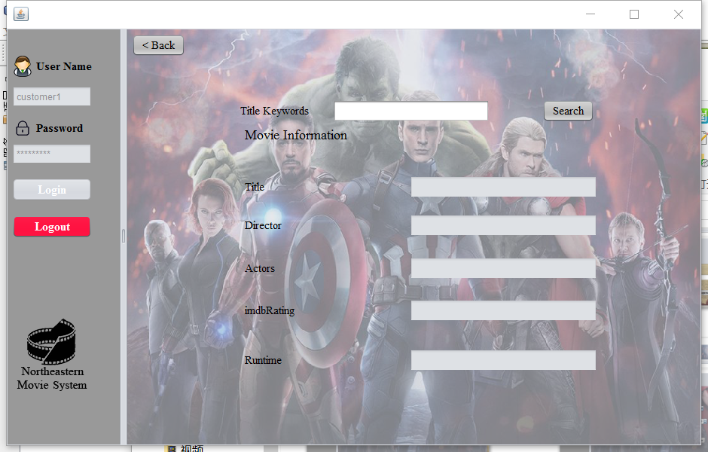
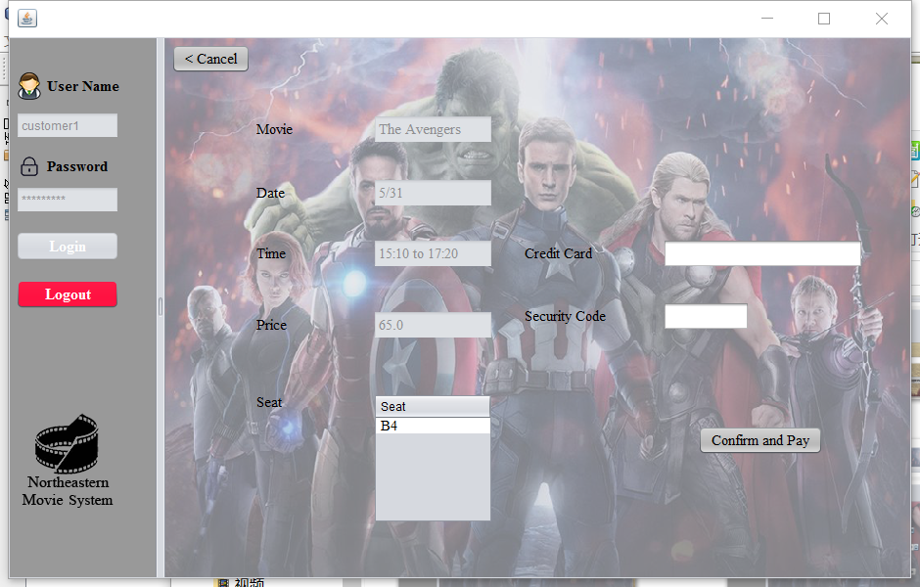
Customer Panel
Creative Part(API)

Slide 28
Thank you!

